Slide 1
Part B Computer Storage
Computer Applications

Slide 2
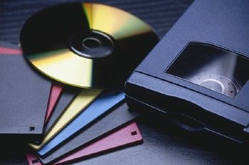
Storage
The place in the computer where data is held while it is not needed for processing
A storage device is device used to record (store) data
The most popular storage devices today are USB drives, internal and external hard disks, CDs and DVDs, and cloud storage

Slide 3
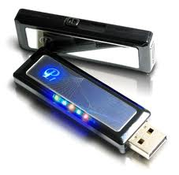
Three Kinds of Storage
Magnetic Storage
Optical Storage
Electronic Storage (sometimes called Flash Storage)

Slide 4
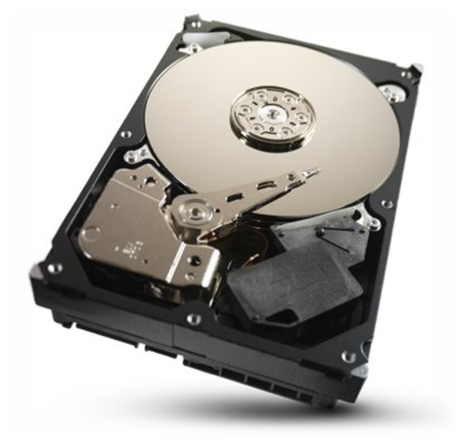
Magnetic Storage
A means of recording or saving data onto disks or tape by magnetizing particles
Information is recorded and retrieved by means of magnetic read/write heads
Magnetic storage devices include: hard drive, floppy disk, digital tape

Slide 5
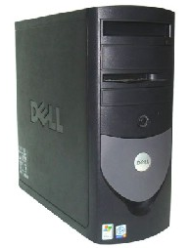
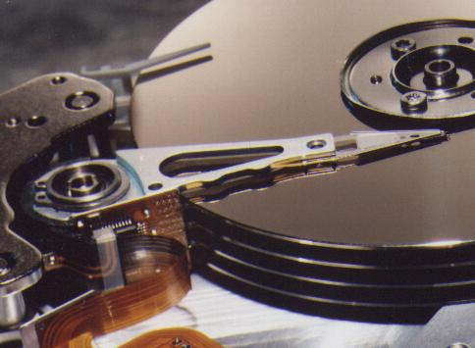
Hard Drive
A mass storage device located inside the computer’s system unit (tower)
Used to store application software and user data
Typical hard drive storage capacity can range from a few hundred Gigabytes up to a few Terabytes

Slide 6
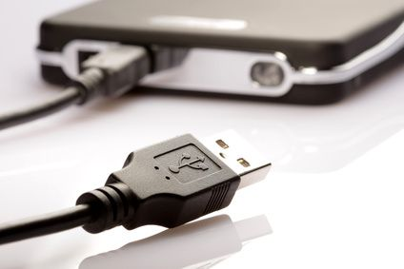
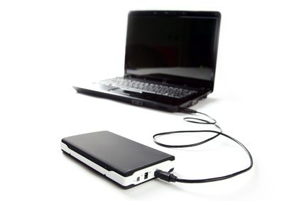
External Hard Drives
A hard drive that has its own separate case and sit outside of your computer’s system unit
Connects to your computer via USB cable
Portable

Slide 7
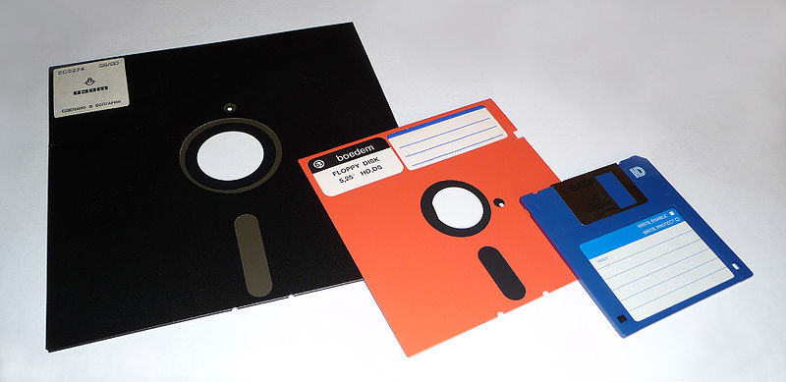
Floppy Disk
The floppy disk, once an icon of the computer age, is becoming obsolete
Stores 1.4 MB
People used floppy disks to store data and transfer it from one location to another
There is not enough room on a floppy disk to store one song or one photo from a high-resolution camera

Slide 8
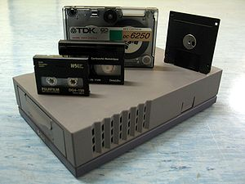
Magnetic Tape
Used by some businesses to backup and archive large amounts of data.
As of 2011, tape cartridges could store up to 5 TB of data.

Slide 9
Optical Storage
Optical storage is the use of low powered lasers to save (burn) and read data from CDs and DVDs.

Slide 10
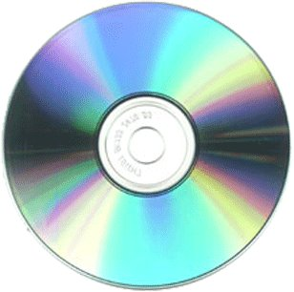
Optical Storage Devices
Storage Device | Description | Storage Capacity
CD | Used to store music, software, and documents | 650 Megabytes up to 1 Gigabyte
DVD | Used to store videos and photos; allows for better graphics and greater resolution photos | Single Sided: 4.7 Gigabytes Multi-layer DVDs like Blue-ray: Up to 500 Gigabytes
CD-ROM, DVD-ROM | Read Only; can never save to this CD or DVD
CD-R, DVD-R | Burn to once; thereafter read-only
CD-RW, DVD-RW | Burn to many times until the CD is full; you can reformat, erase and rewrite to them

