Slide 1
Part C Computer Storage
Computer Applications

Slide 2
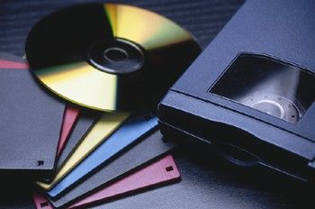
Storage
The place in the computer where data is held while it is not needed for processing
A storage device is device used to record (store) data
The most popular storage devices today are USB drives, internal and external hard disks, CDs and DVDs, and cloud storage

Slide 3
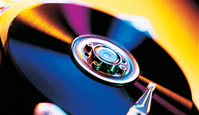
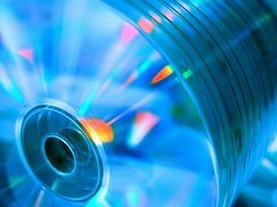
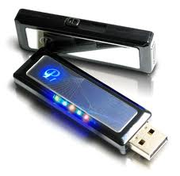
Three Kinds of Storage
Magnetic Storage
Optical Storage
Electronic Storage (sometimes called Flash Storage)

Slide 4
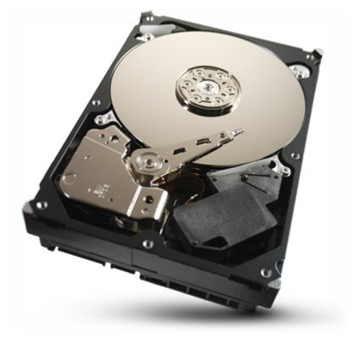
Magnetic Storage
A means of recording or saving data onto disks or tape by magnetizing particles
Information is recorded and retrieved by means of magnetic read/write heads
Magnetic storage devices include: hard drive, floppy disk, digital tape

Slide 5
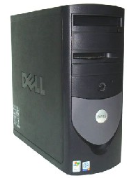
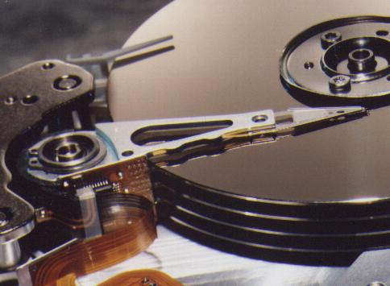
Hard Drive
A mass storage device located inside the computer’s system unit (tower)
Used to store application software and user data
Typical hard drive storage capacity can range from a few hundred Gigabytes up to a few Terabytes

Slide 6
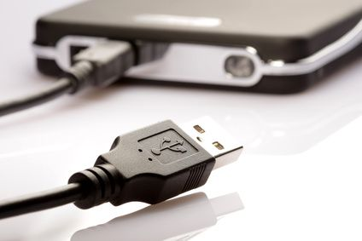
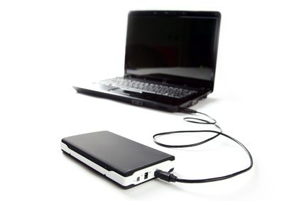
External Hard Drives
A hard drive that has its own separate case and sit outside of your computer’s system unit
Connects to your computer via USB cable
Portable

Slide 7
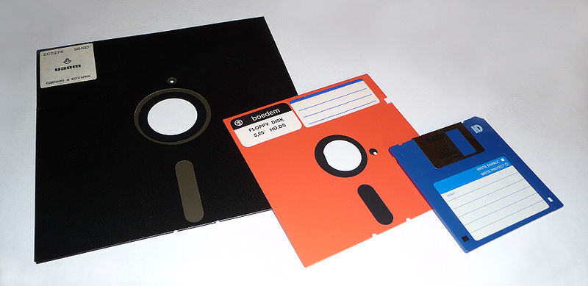
Floppy Disk
The floppy disk, once an icon of the computer age, is becoming obsolete
Stores 1.4 MB
People used floppy disks to store data and transfer it from one location to another
There is not enough room on a floppy disk to store one song or one photo from a high-resolution camera

Slide 8
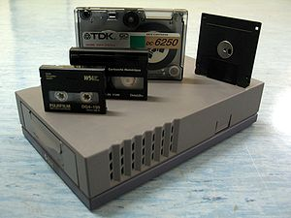
Magnetic Tape
Used by some businesses to backup and archive large amounts of data.
As of 2011, tape cartridges could store up to 5 TB of data.

Slide 9
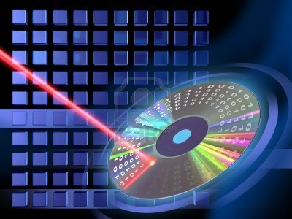
Optical Storage
Optical storage is the use of low powered lasers to save (burn) and read data from CDs and DVDs.

Slide 10
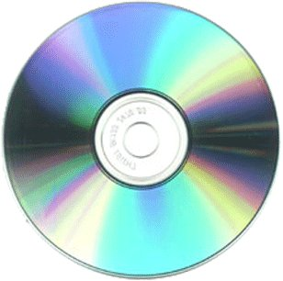
Optical Storage Devices
Storage Device | Description | Storage Capacity
CD | Used to store music, software, and documents | 650 Megabytes up to 1 Gigabyte
DVD | Used to store videos and photos; allows for better graphics and greater resolution photos | Single Sided: 4.7 Gigabytes Multi-layer DVDs like Blue-ray: Up to 500 Gigabytes
CD-ROM, DVD-ROM | Read Only; can never save to this CD or DVD
CD-R, DVD-R | Burn to once; thereafter read-only
CD-RW, DVD-RW | Burn to many times until the CD is full; you can reformat, erase and rewrite to them

Slide 11
Electronic Storage
Electronic storage is the use of a chip to electronically save, erase or reprogram data
Examples of devices that use Electronic Storage:
SD (secured digital) Cards, Flash Drives, Solid State Drives
Faster because it does not contain movable parts

Slide 12
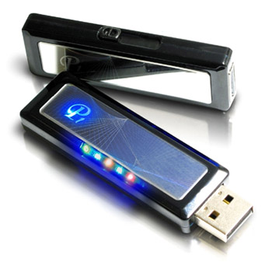
Flash Drive
A portable storage device that uses electronic storage and has an integrated USB port
Flash drives have many names including:
USB Drive, thumb drive, jump drive
Simple form of transporting data to and from school or work
Storage capacity: anywhere from a few hundred megabytes up to 1 TB

Slide 13
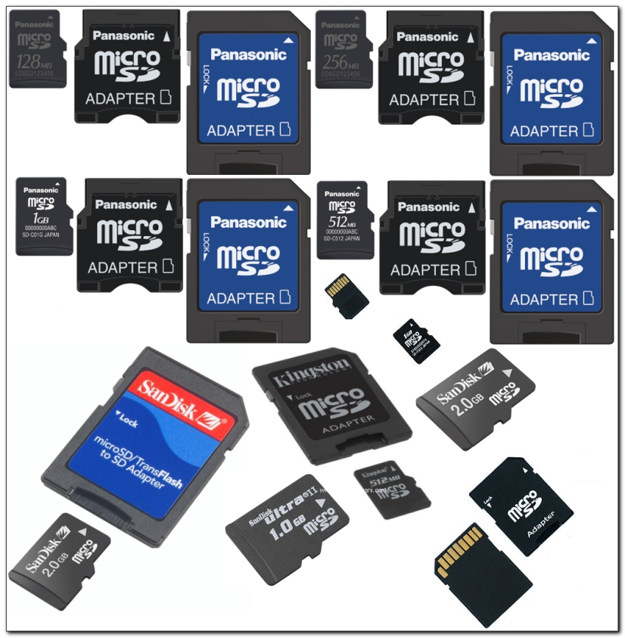
Memory Card
A memory card is also known as a flash card, SD Card or memory stick
Used for storing data in digital cameras, mobile phones, as well as some MP3 players, and video game consoles.
Storage capacity: Anywhere from 64 Megabytes up to 2 Terabytes

Slide 14
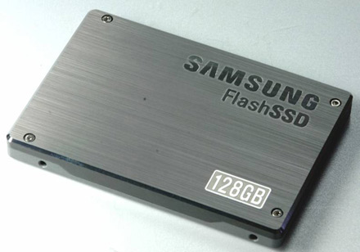
Solid State Drive
SSD stands for Solid State Drive
Uses flash memory
It means that data is stored to devices via electronic semiconductors that are built from solid materials that have no moving parts

Slide 15
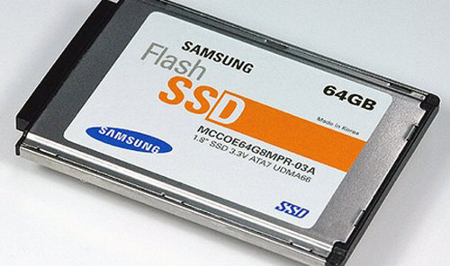
Solid State Drives
Solid State Drives reside inside the computer in place of the local hard drive
Faster than a hard drive because it has no moving parts
Storage is handled by a flash memory chip
Use less power, and are much more reliable than hard drives

Slide 16
SSDs continued…
So… Why aren’t SSDs used for all PCs today?
Cost!
They cost 10 to 17 times more than a similar hard drive.
The 800GB SSD is priced at $3,859, while the 400GB SSD is priced at $1,929 (PC World, July 2012)
Storage Capacity!
The average SSD stores 128 to 256 Gigabytes
Hybrid: Combination of SSD and hard drive
Some corporations use hybrid technology to speed up servers

Slide 17
What is the Cloud?

Slide 18
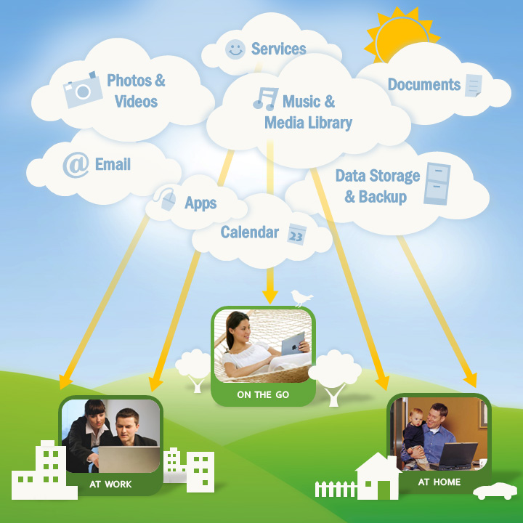

Slide 19
Software as a Service
AKA--SaaS
No need to buy software and install it on your computer
SaaS allows you to rent access to software
Software is not installed on your PC—instead it is installed and run on computers operated by a software supplier
You pay to access to the software via the Internet
Example: Office 365

Slide 20
Why Use the Cloud?
Cost—Allows companies to pay for storage space rather than servers and the personnel to service them
Convenience –You can access your data from any device that has an Internet connection
Safety—Hard Drive crashes? No problem! You can access the data from a different computer or device
Collaboration—The cloud makes it much easier to share a file with coworkers family or friends

Slide 21
Cloud Computing and Security
Is the cloud secure?
Proceed, but with caution…
You are less likely to lose your data due to equipment failure, fire, etc.
There is always a risk that someone may try to gain access to your personal data
It is important to choose a strong password and pay attention to any privacy settings offered by the cloud service you're using.

Slide 22
Works Cited
www.gfclearnfree.org
www.youtube.com/watch?v=tjLB5QCXeTQ

