Slide 1
Types of Computers
Computer Applications

Slide 2
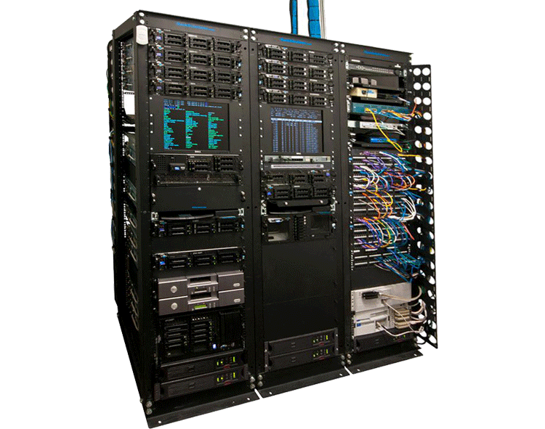
Server
A computer that provides users with access to files and printers on a network
Has a large processors and many hard drives
Where network documents and web pages are stored
Used in schools, doctors offices, small companies
Makes it possible to access documents on any network computer in the building

Slide 3
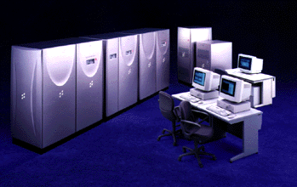
Mainframe
A Large, powerful computer that carries out different tasks for thousands of people at the same time
Mainframes can process large volumes of data quickly and securely.
They must be operated by trained specialists and kept in air-conditioned rooms away from the office or factory floor.

Slide 4
Mainframes are used for:
Utility Companies (Gas and Electricity suppliers)--for billing
Banks –for managing your accounts
Insurance Companies—managing policies
Airlines—reservations and ticket processing
Police—crime detection

Slide 5
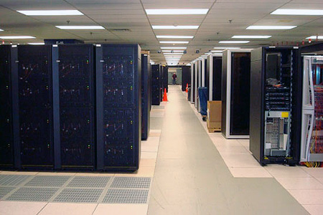
Supercomputer
The fastest and most expensive computers in the world at the time it is created
They perform quadrillions of complex calculations in a very short time

Slide 6
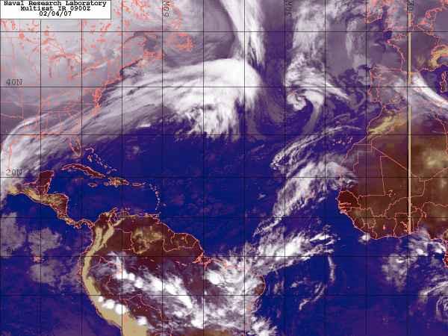
Supercomputers are used for:
Weather forecasting
Space exploration
Scientific research
Military weapons research
Pharmaceuticals and Drug testing

Slide 7
Supercomputers continued…
Generate lots of heat; air-conditioning required
Miles of cables connect the computer to peripherals
Requires its own electricity generator
Need special filters installed to keep the atmosphere free of dust particles
Can tackle huge real world calculations that would be too time consuming to be completed by an individual or any other type of computer
Speed and accuracy of calculations

