Slide 1
Know Your Charts
Unit 3 Excel

Slide 2
Charts
A chart is a graphical representation of data
Column Charts:
show relationships among categories of data
Line Charts:
show trends over time
Pie Charts:
show relationship of a part to the whole
Scatter Charts:
show relationship between two categories

Slide 3
Charts How are They Displayed
Embedded Chart:
Created within the worksheet
This is the default location

Slide 4
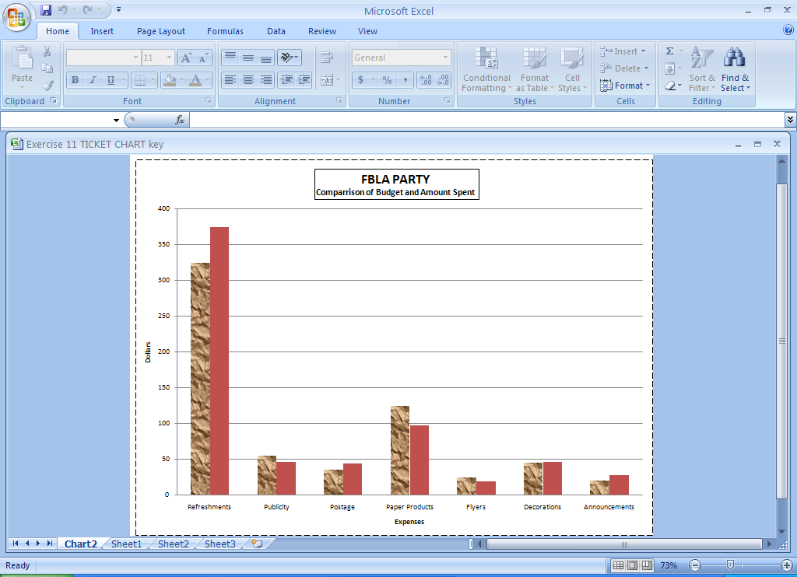
Charts How are They Displayed
Chart Sheet:
This appears as a separate sheet in the workbook
You have to move the chart in order for it to be displayed on a separate sheet.

Slide 5
How to Place Chart on a New Sheet
Click the embedded chart or the chart sheet to select it and to display the chart tools.
On the Design tab, in the Location group, click Move Chart.
Under Choose where you want the chart to be placed, do one of the following:
To display the chart in a chart sheet, click New sheet.

Slide 6
Steps to Create a Chart
Select the data to be charted
This usually DOES NOT include Totals!
Choose Insert Tab
Choose Chart type
Select Chart Layout

Slide 7
Renaming a Sheet
Right click on the sheet tab
Rename

Slide 8
Working with the Chart
To change items on the chart
Right click on the chart area
To resize the chart
Click on the sizing handles and drag to new size
To move the chart on the sheet
Click in white area of chart and drag to new location
To Copy the Chart
Right click in Chart area and choose copy

Slide 9
Working with Charts
Everything in a chart is an object to change the appearance of an object you can
Use the Chart Tools tab
Double click to open the formatting dialogue box
Right click and choose the appropriate tool

Slide 10
Working with Charts
Selecting non-adjacent cells (cells that do not touch)
Select the first range
Hold down the Control Key (ctrl) and select the next range.
Pie Charts can show only 1 range of information at a time.

Slide 11
Working with Charts
To Insert a title you must choose a layout that includes a title or insert a textbox or WordArt.
Add a Sub-Title by using a layout that contains one or entering after Title and adding sub-title.

Slide 12
X axis is the horizontal
Y axis is vertical
Gridlines help make charts easier to read by adding lines.
Legend identifies colors and patterns within the chart
Legend
Y Axis
X axis

