Slide 1
Types of Computers
Computer Applications
Unit 2 Part 4

Slide 2
So how fast is a Petaflop?
This short 2 minute video explains!

Slide 3
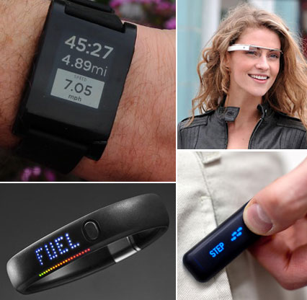
Wearable Computers
Electronic devices that are integrated into watches, wristbands, belts, glasses, or even clothing!
Advantages:
Constant interaction between the device and the user
Hands are free—Not necessary to stop what your are doing to use the device.

Slide 4
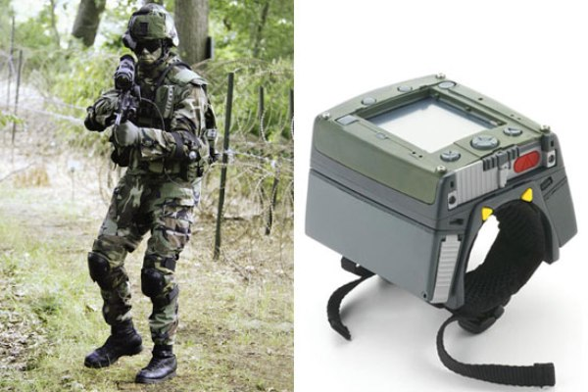
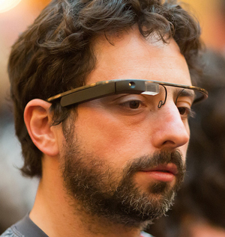
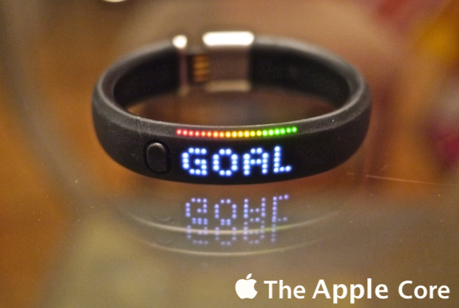
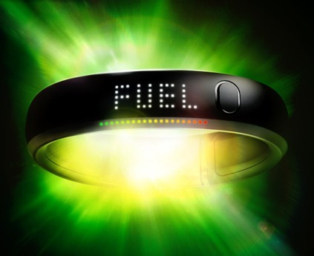
Wearable Computers Uses:
Military
Health and Fitness
Commerce
Navigation
Gaming
Notes:
Military
Military demands are similar to consumer demand: low power, lightweight, high performance, and long battery life. Small handheld wearable computers enable a soldier to free one or both hands, which means a more alert soldier than one sitting at a laptop.
A large push is under way to improve video capability on wearable displays to better take advantage of sensor fusion and provide situational awareness not only to battlefield commanders, but also down to individual soldiers.
An example of this is sending images taken from unmanned-aerial-vehicle surveillance directly to the wearable devices in special-operations units and reconnaissance forces. This approach would let them see what the UAV sees.
http://www.militaryaerospace.com/articles/print/volume-16/issue-11/features/technology-focus/wearable-computers-and-the-military-the-smaller-the-better.html
Wearable Computer capabilities
“Imagine video games that happen in real space. Or glasses that remind you of your colleague’s name that you really should know. Or paying for a coffee at Starbucks with your watch instead of your phone. Wearables will transform our lives in numerous ways, trivial and substantial, that we are just starting to imagine.”
The above is quoted from the NY Times technology blog located at http://bits.blogs.nytimes.com/2012/04/17/wearable-computers-are-the-next-platform-wars-report-says/
It is an outstanding article about wearables and the future.
Health and Fitness
Link to a super article about the Nike FuelBand, a wearable fitness computer
http://www.zdnet.com/blog/apple/nike-fuelband-the-wearable-fitness-computer/12813

Slide 5
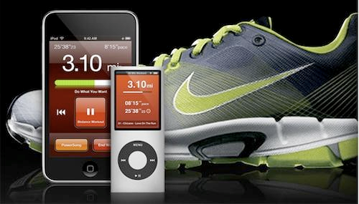
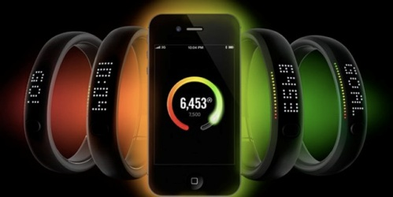
Nike Fuel Band & Nike Plus Shoes

Slide 6
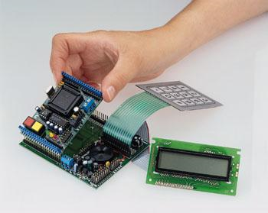
Embedded Computers
A single chip that contains all of the elements essential for any computer
RAM / ROM
CPU
Input / Output
Clock

Slide 7
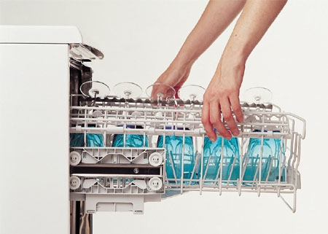
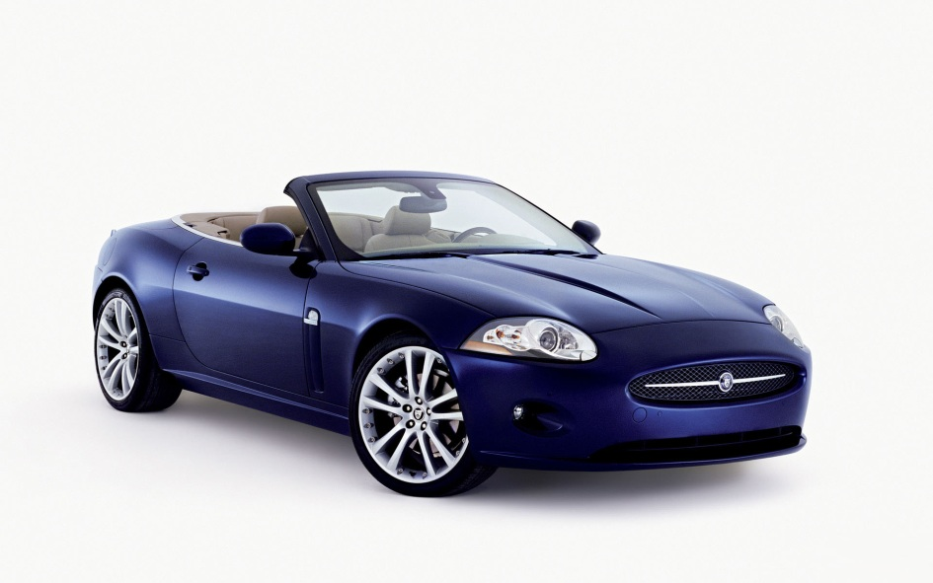
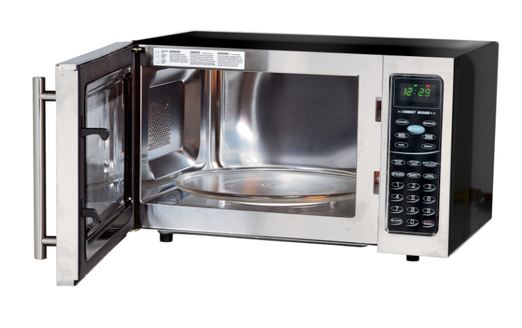
Embedded Computers Continued…
Computer chips are now cheap enough to install in everyday items.
Telephones
Televisions
Microwaves
Washing machines
Cars

